Slide 2
Message from Dan
D5100 current position

Slide 3
Make up of Committee
Chair-Dan Boldt (2018-21) Bill Paulsen (2021-24)
Vice Chair-Bill Paulsen (2018-21)
Treasurer-Bruce Frederick Assistant (Visa Charges) Barbara Lauritzen
Outbound Coordinator- Terry Mohr (2018-21)
Inbound Coordinator-Steven Goto (2018-21)
Rebound Coordinator-Barbara Lauritzen (work with ROTEX)
STEP Coordinator-Tina Scheible
Secretary/Communications – Marie Johnson
Country officers: Barbara Lauritzen(Austria, Germany, Switzerland), Dan Boldt (Finland, Estonia, Belgium, Nigeria), Bill Paulsen (Denmark, Chile, Italy), Terry Mohr (Turkey, Taiwan, Russia), Sparky Vaubel (Brazil, Argentina), Mark Derry (Mexico, Colombia, Ecuador ), Joyce Forsyth (Thailand, Czechia and Slovakia), Steven Goto (Japan), Lorrie Davis-Meyer (India, France), Danny Lonai (S. Korea)
YEAH compliance and all questions YEAH-Steve Schwab
Other District committee members: Maureen Casterline, Chris Taylor. Steve Cousineau
Assistants (ROTEX) Molly Hinsvark (Thailand), Ervanny Astari (Japan, S. Korea), Johnny Archer (Austria, Germany, Switzerland), Dylan Schetchel (Belgium, Finland, Nigeria), Anna Galloway (Argentina), August Harrison (Brazil), Emily Baker (Taiwan) Plus a lot of other ROTEX who are not assistants.

Slide 4
What Committee Members Do
Chair-runs YE committee
Vice Chair-back up for Chair
Treasurer-Takes all fees (inbound & outbound)
Assistant Treasurer-all visa charges for Optional trip and merchandise
Outbound Coordinator-Handles outbound applications to make sure they are complete and plans outbound orientation
Inbound Coordinator-Makes sure all inbounds information is being received and plans Inbound orientation
STEP-Handles all outbound and Inbound applications and matching of families
Secretary/Communications-sends all emails to clubs, Host families and students (inbound and outbound)
Country Officers-handles all paperwork for their country for both inbound and outbounds. Keep tabs on all students for their country. If there is a problem with a student, they are first contact for that student if club is having a problem.

Slide 5
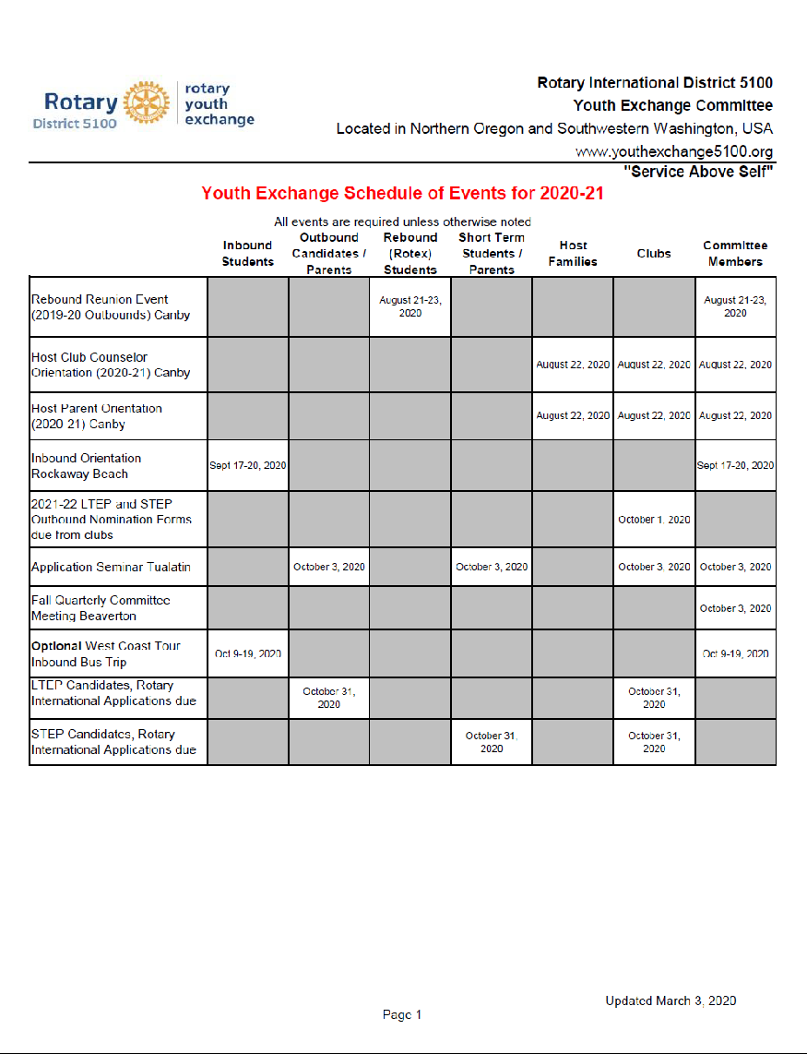
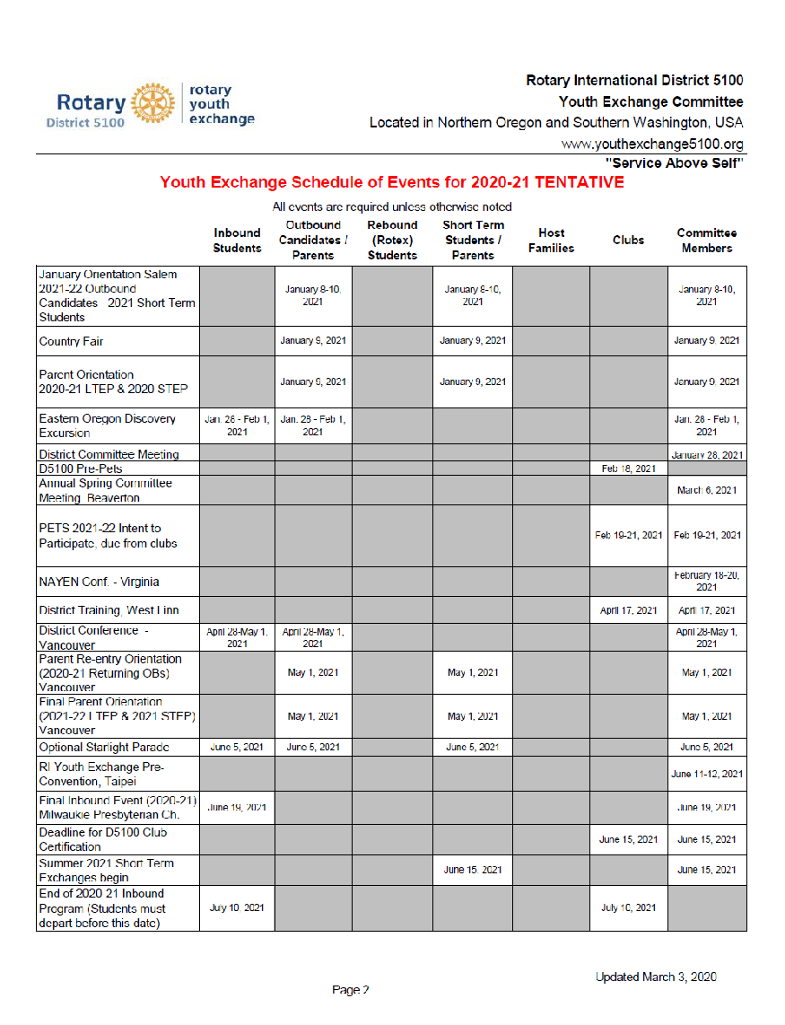
2020-21 Schedule

Slide 6
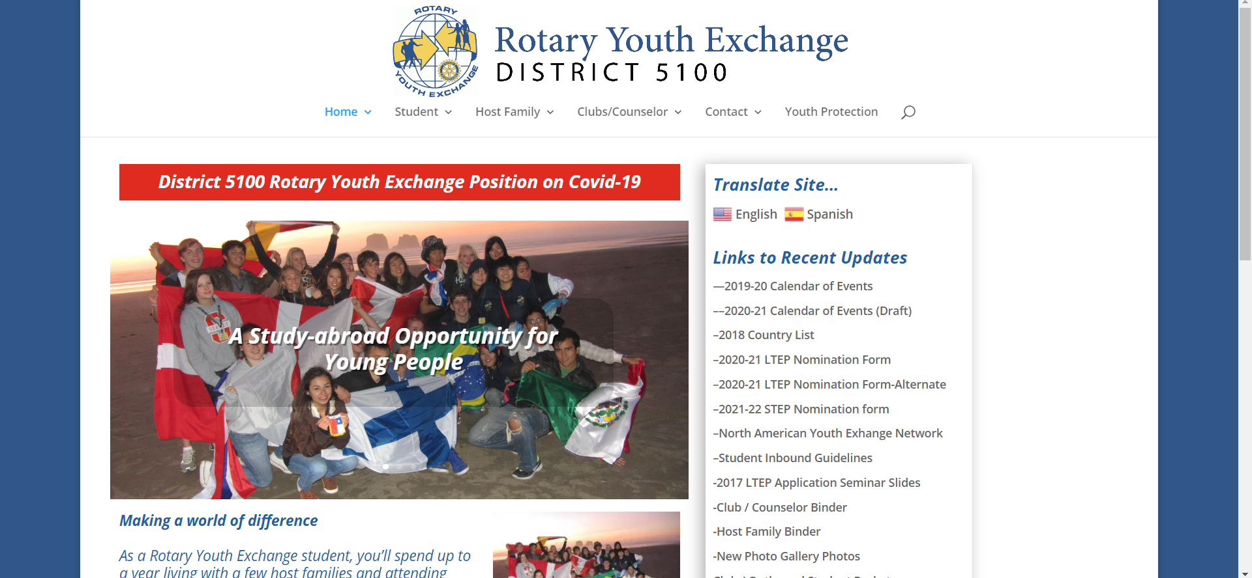
Website www.youthexchange5100.org

Slide 7
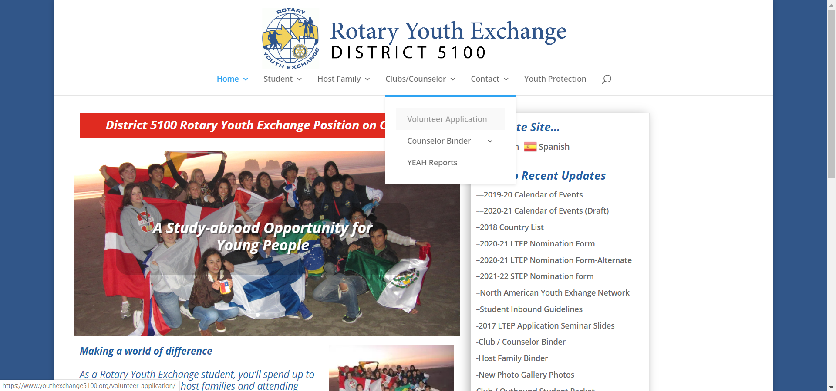
How to get set up as a Volunteer
All club YEOs and counselors need to be set up as a volunteer

Slide 9
What is needed to be an Approved Volunteer?
Online application with 3 References only ONE may be a Rotarian, the other 2 must be non Rotarians and all must be non family members (You will need their email address and phone numbers). You Must Do This First. Tell your references you are using them and to expect email.
Background check (automatically sent after application is submitted)
DOS training-US Dept of State 30 question test so you understand the rules of Youth Exchange-(Link email automatically sent after application is accepted-now run by NAYEN)
2nd NAYEN Training-our YPA-Youth Protection Awareness training, 20 question test-(Link email automatically sent after application is accepted)
Volunteers must have both training.
US Dept states we must have 2 references that are not a part of the organization, Rotary wants 3 references hence the above rules for references
DOS uses the term “local area coordinator”. It considers all volunteers local area coordinators.

Slide 10
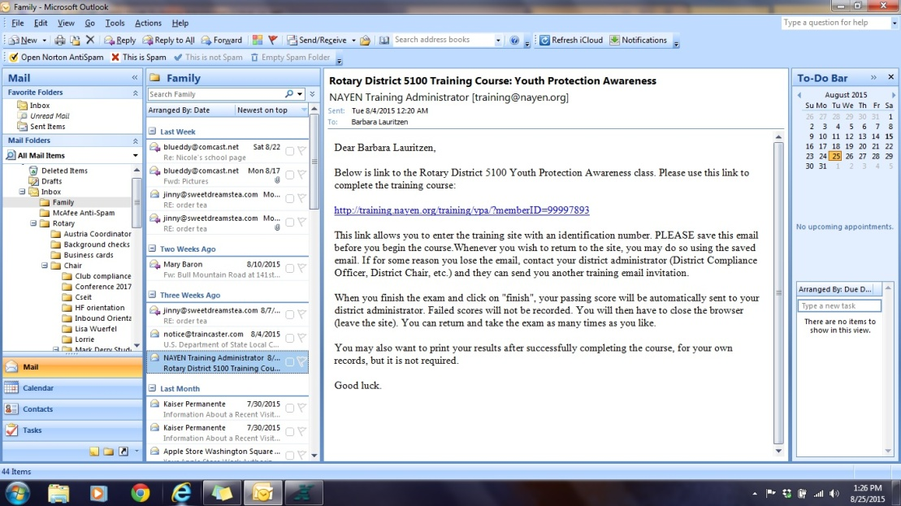
Emails for Training/testing
One of two emails
NAYEN Email-All volunteers and Host Families members over 18 receive-on Youth Protection Awareness (YPA)

Slide 11
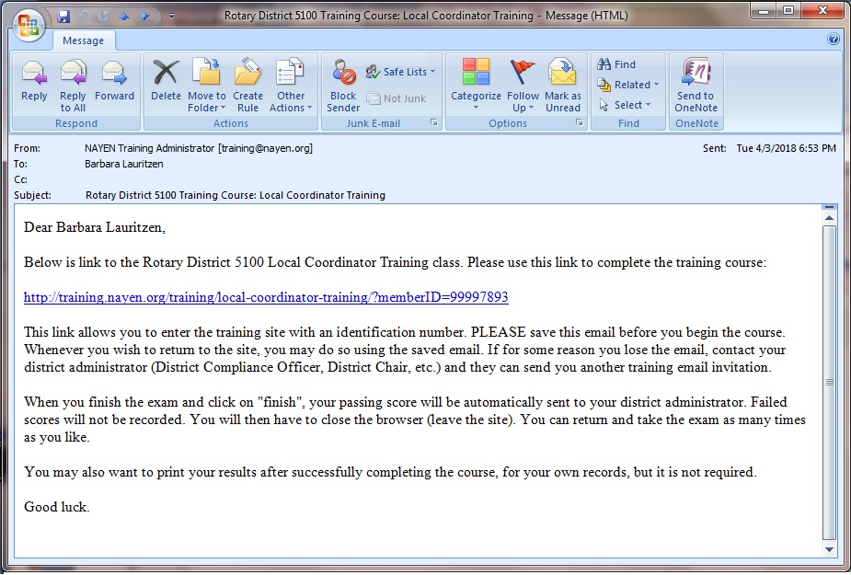
Emails for Training/testing
DoS-Dept of State email-Only volunteers receive- It is on how Youth Exchange runs. All volunteers are called coordinators-DoS term.
Local Coordinator training and test now run by NAYEN.
Second of two emails.

Slide 12
Once Approved, you have access to YEAH Portal
On a secure server, which is why it requires special link to do applications. Rotary YEAH users are not visiting a website. They are using a link to create a client-server connection.

Slide 13
What is in the YE Database?
Information
Automation
Administration
YEO Portal
Your Students
Contact Information
Flight Itineraries
Insurance Details
Links to Maps
Generate ID Cards
Your Host Families
Contact Information
Host Student History
Links to Maps
Directory & Library
Officers, District Chairs, etc.
Reference Material
Web Forms
Monthly Counselor Reports
Host Family Changes
Home Visit/Interview
Follow-up HF (2nd Visit) Reports
Host Family Applications
Volunteer Applications
Outbound Applications
Itinerary Uploads
Insurance Uploads
Auto Processing
Host Family Applications
Web Form including Photos
Reference Requests
Volunteer Applications
Web Form including Photo
Reference Requests
DOS Traincaster Integration
IB Student Registrations
Web Form including Photo
IB SEVIS Info
Insurance Integration
Outbound Student Applications
Complete Web Form
Reference Request
App Package Creation
Host Family Changes
Confirmation Messages
Notification to RI
Prior Host Family Survey
New Student ID Cards
Reminders
Monthly Reports
Pending Applications/Referrals
Overdue Reports
More…
YE Admin Hub
Current & Historical Data
Students
Host Families
Volunteers
Schools, Clubs, Countries, etc.
Clear Tracking with Progress Indicators
Full Approval Process for HFs & Vols
Alerts and Event Notifications
Import Prior Data & Reference Files
E-mail Message Generation
Text Message Generation
Variety of Reports
Data Export to Spreadsheets
Payment Tracking & Register Report
SEVIS-ready Data Screens
One-touch DOS Placement Reports
Document Bundling for CSIET Audits

Slide 14
Where to find login for Portal

Slide 15
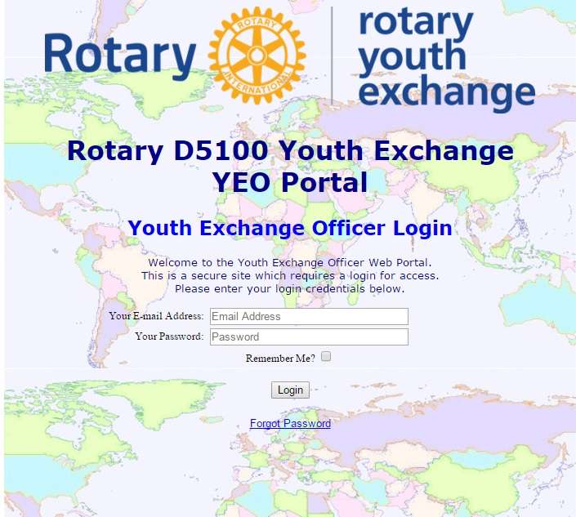
Login Page once Approved
YEO Portal
Your Students
Contact Information
Flight Itineraries
Insurance Details
Links to Maps
Generate ID Cards
Your Host Families
Contact Information
Host Student History
Links to Maps
Directory & Library
Officers, District Chairs, etc.
Reference Material
Web Forms
Monthly Counselor Reports
Host Family Changes
Home Visit/Interview
Follow-up HF (2nd Visit) Reports
Host Family Applications
Volunteer Applications
Outbound Applications
Itinerary Uploads
Insurance Uploads

Slide 16
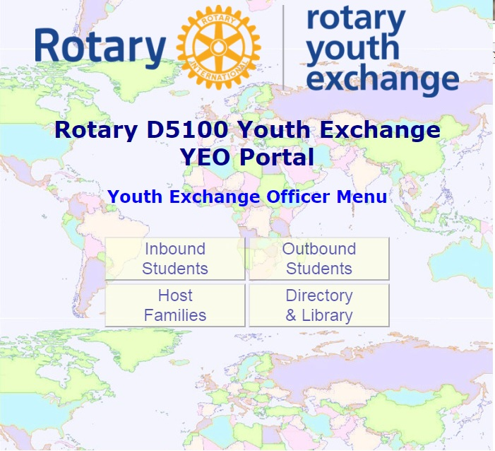
Choices on Portal
YEO Portal
Your Students
Contact Information
Flight Itineraries
Insurance Details
Links to Maps
Generate ID Cards
Your Host Families
Contact Information
Host Student History
Links to Maps
Directory & Library
Officers, District Chairs, etc.
Handbooks, Reference Material
Web Forms
Monthly Counselor Reports
Host Family Changes
Home Visit/Interview
Follow-up HF (2nd Visit) Reports
Host Family Applications
Volunteer Applications
Outbound Applications
Itinerary Uploads
Insurance Uploads

Slide 17
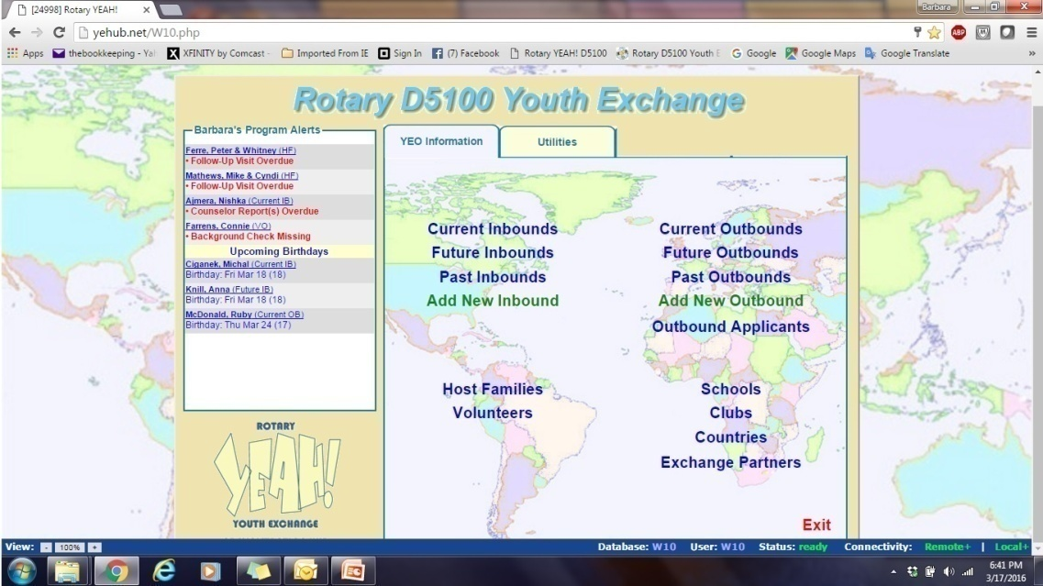
YEOs only HUB Access

Slide 18
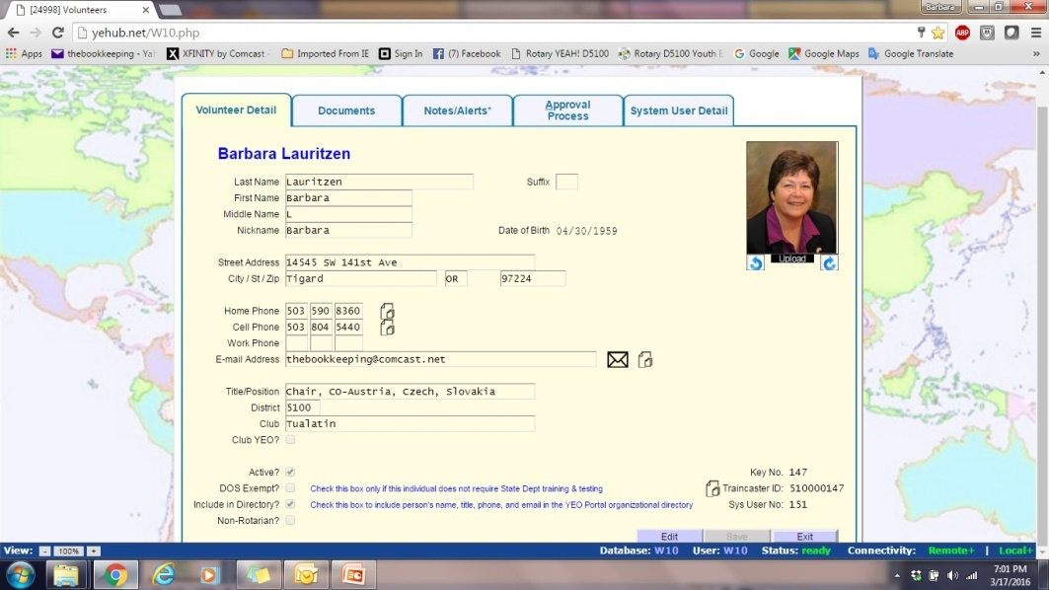
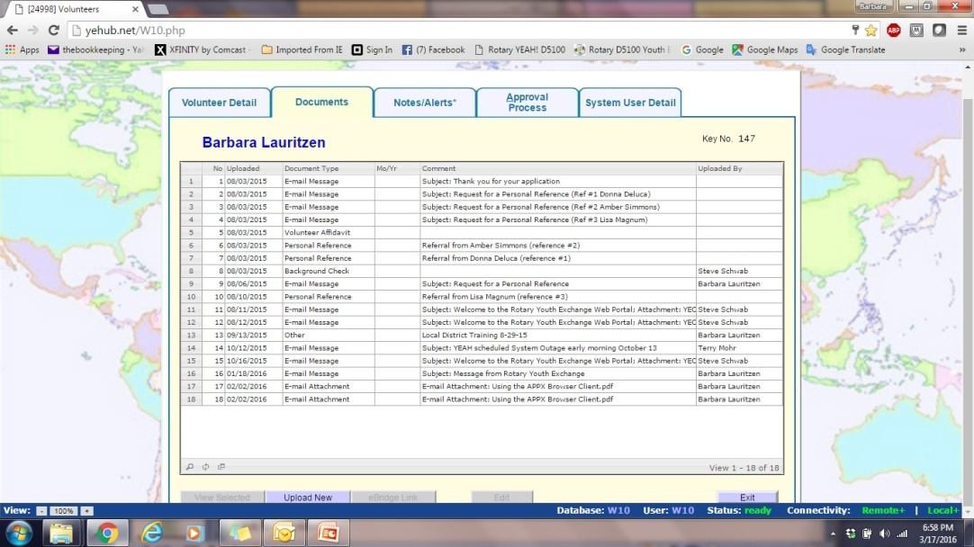
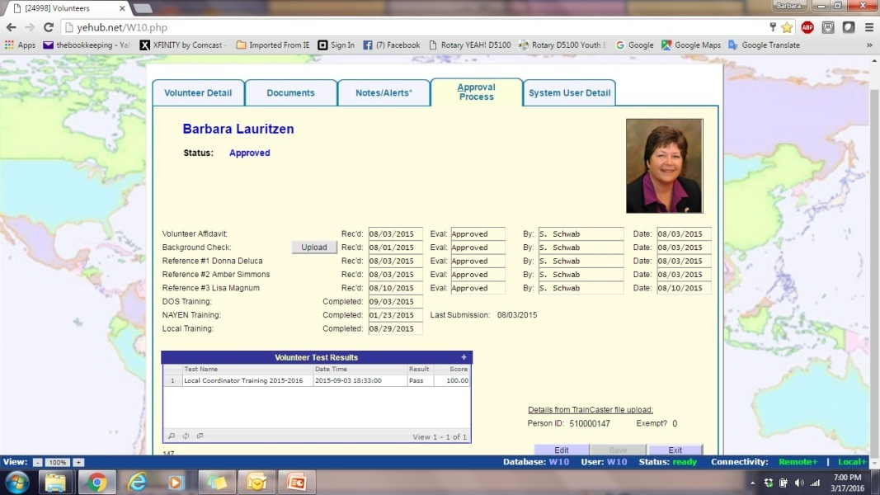
YEOs only HUB Access

Slide 19
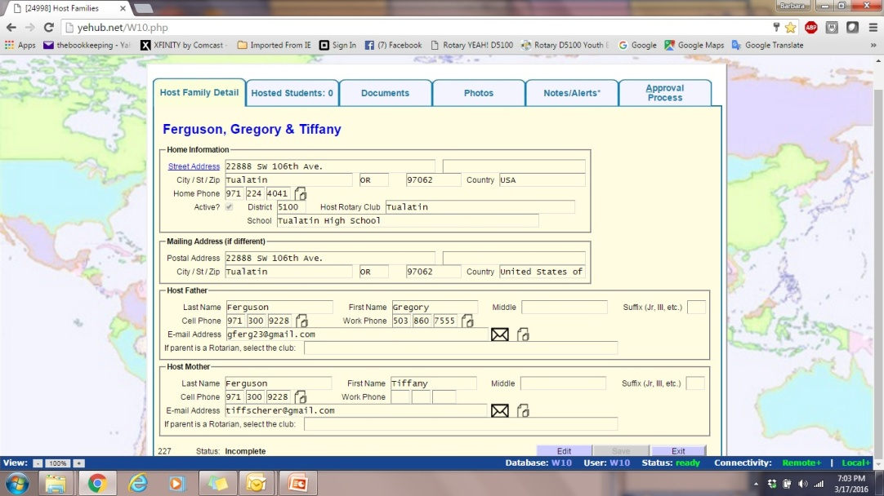
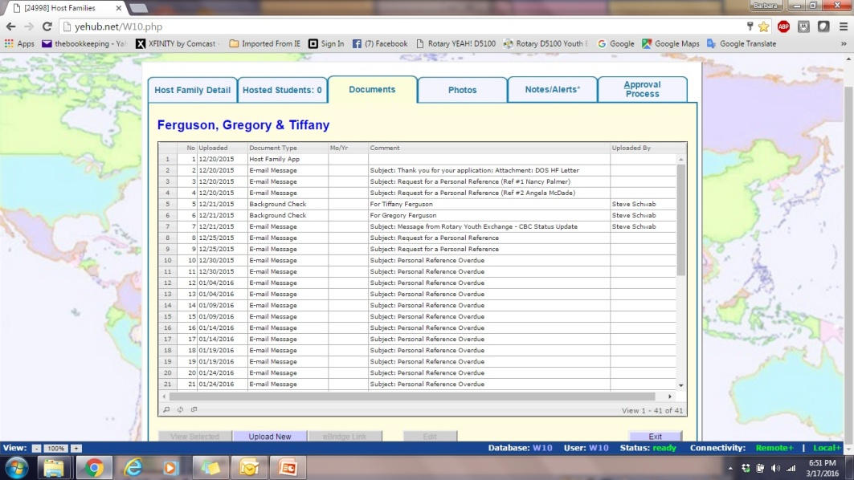
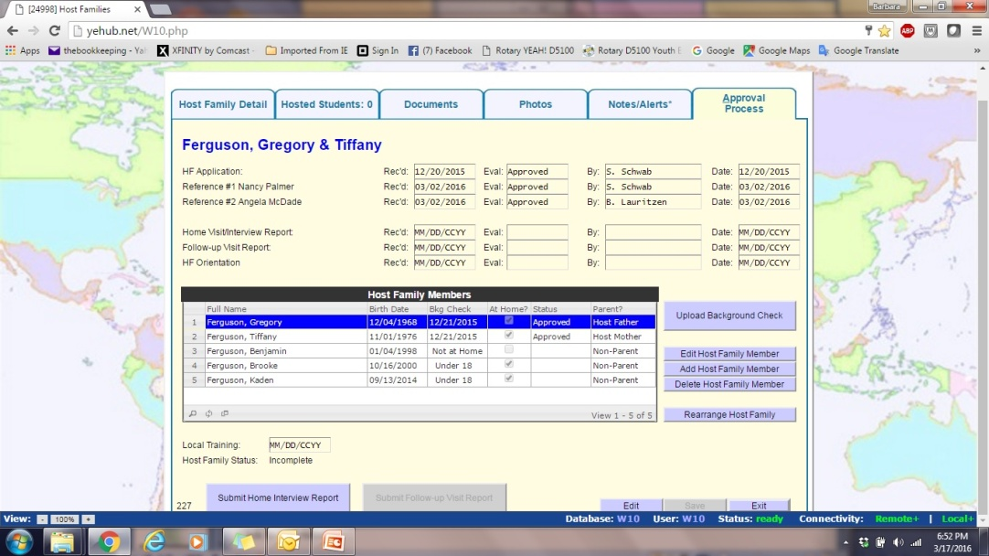
YEOs only HUB Acccess

Slide 20
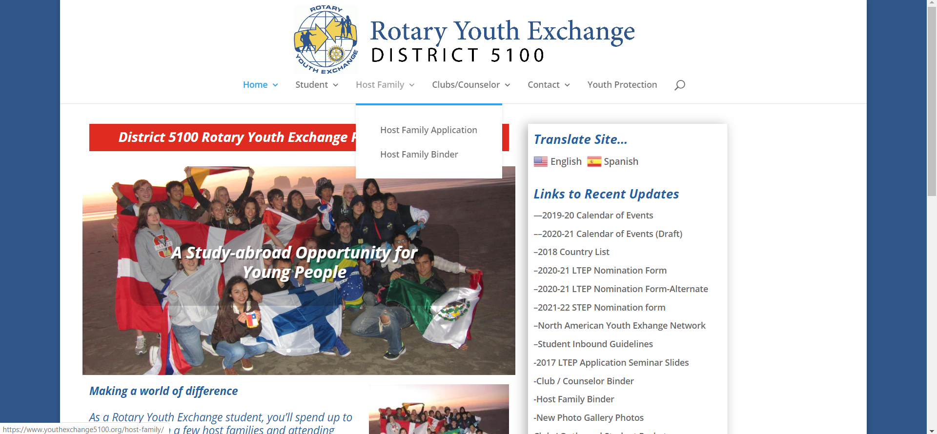
How to get a HF application

Slide 21
What is needed for HF
HF Application only (online)Must Be Done First.
Only 2 References (online and ALL non Rotarians and non family members)
Background Check (plus they will need the NAYEN YPA 20 question test-links will automatically be sent after application is submitted)
Home Visit/Interview Report (Club does thru the portal, online)
HF Orientation form (this is both on our website and in the library in the portal. It must be sent to a district person to upload. This must be done last.)
Make sure the Host Families knows your club so they can fill it in. If no club is filled in, you will not be able to see them.

Slide 22
Find Visit/Interview with HF in Portal

Slide 23
Questions for Visit/Interview

Slide 24
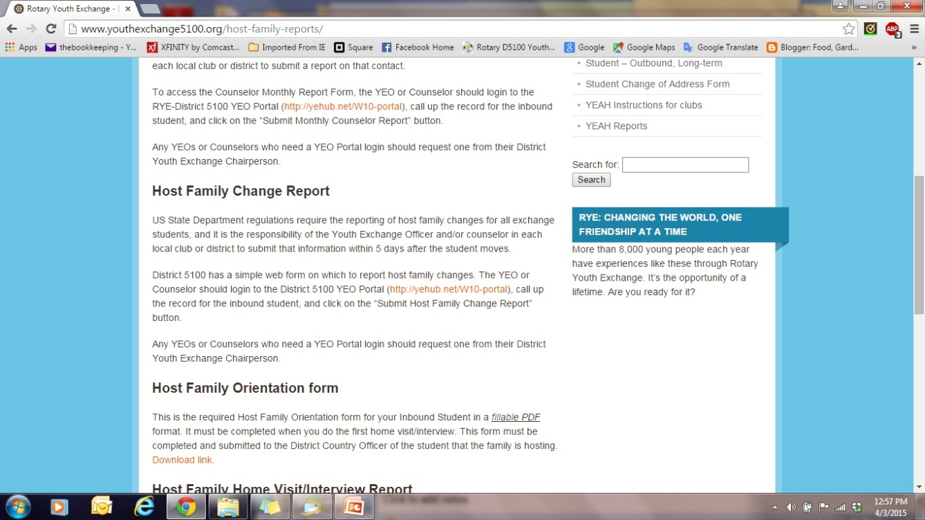
Where to find HF orientation form

Slide 25
Host Family Binder
Note: There is a tax deduction of $50 a month for hosting an exchange student. Ask tax preparer about it.

Slide 26
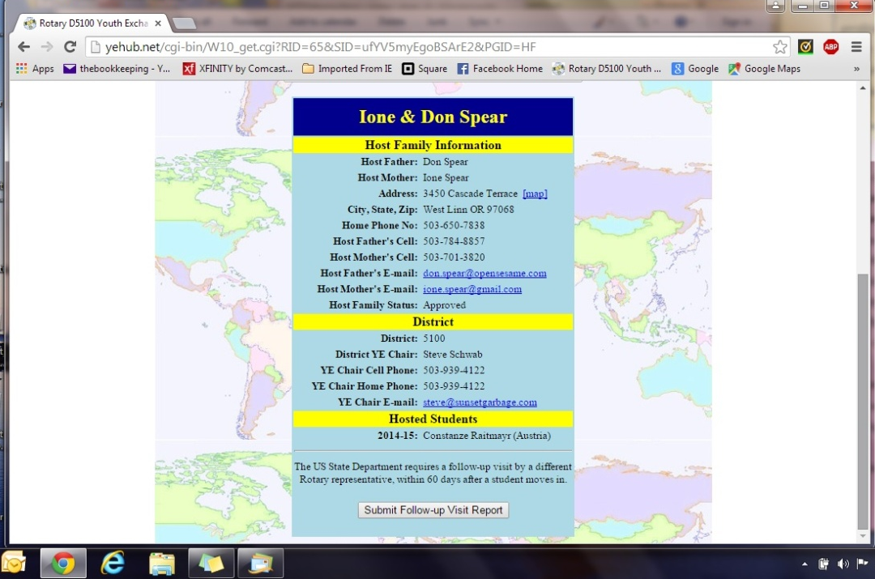
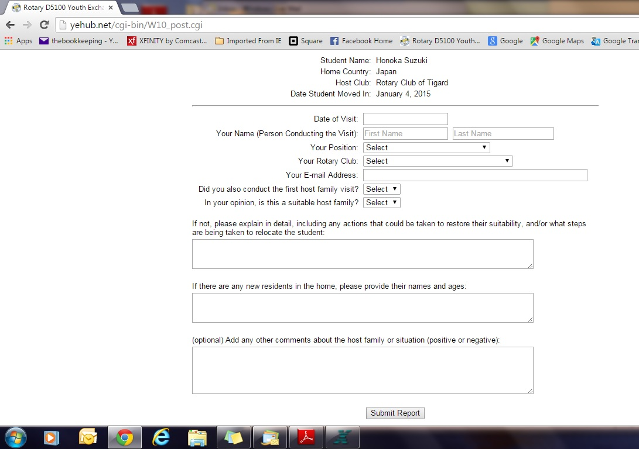
After student has moved in
Must have a visit in the home within 60 days by someone who did not do initial visit
All other monthly reports with HF will be on student monthly report.
Can be email, phone or in person. Can be by one person or two people

Slide 27
What does the counselor do?
Club Binder has a section on Counselors
Be an Advocate for the student
Support the student and make student feel a part of the Rotary Family
Be the liaison between student, Rotary Club, school and community
Provide guidance and counseling to student
Assist student in adapting to our culture and language
Maintain and document all regular meetings with student into YEAH
Listen attentively to student’s comments and concerns
Work with Club YE committee and District YE country officer if any serious incident has occurred involving student, HF or other volunteer which requires immediate intervention
Do monthly reports

Slide 28
Quirks of the system
After filling in a report, button will disappear once the report is approved by a district person. If no button, report has been entered.
After someone gives a reference or a monthly report, they are not given an acknowledge, it just goes to a blank page.
Need to have at least 2 people from each club, a YEO and a counselor due to reports and emails. They need to be YEAH approved
Club YEO’s will be receiving emails about new applications and references.
If an application is submitted and needs changes, do the changes thru a district person. If applicants resubmits it starts the initial process again…BGC email, reference emails.
Can not type date, must use pop up calendar.
If you fill in a host family move in date before a student arrives, it will show the student has arrived.

Slide 29
YEAH System Clearance Matrix
 | Application | CBC | Reference Checks | Interview | NAYEN Training | DOS Trainning | Local Training
Volunteer | 3 Years | Annual | 3 Years | 3 Years | Annual | Annual | Once
Host Family | 18 Months | 18 Months | 18 Months | 18 Months or per student | Annual | N/A | 18 Months or Per student-HF orientation

Slide 30
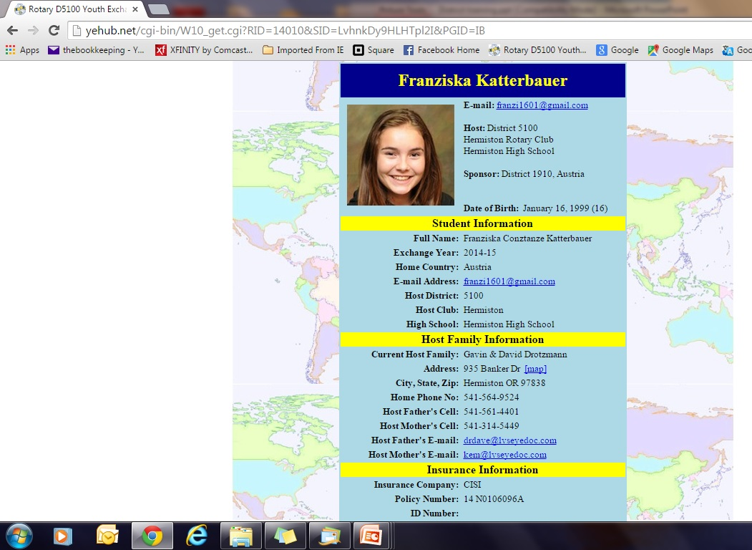
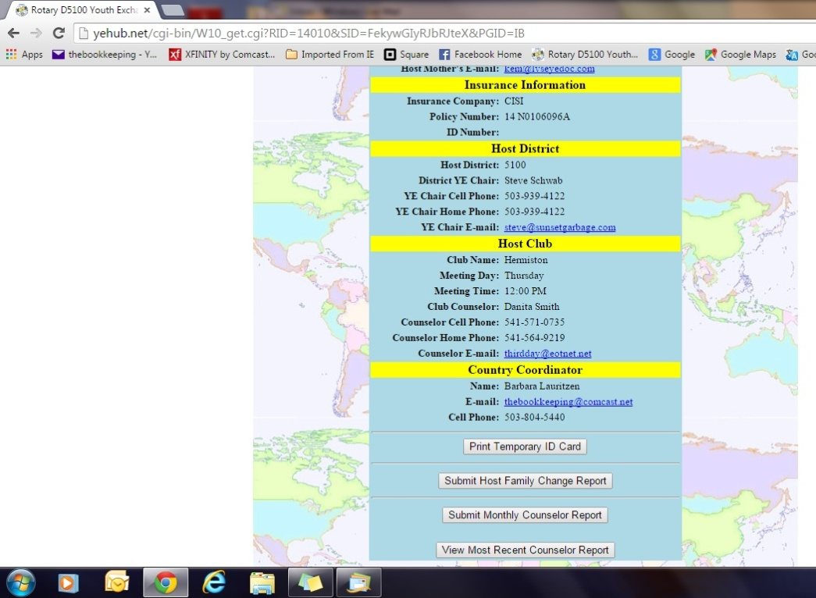
Inbound students

Slide 31
Club/Counselor Binder

Slide 32
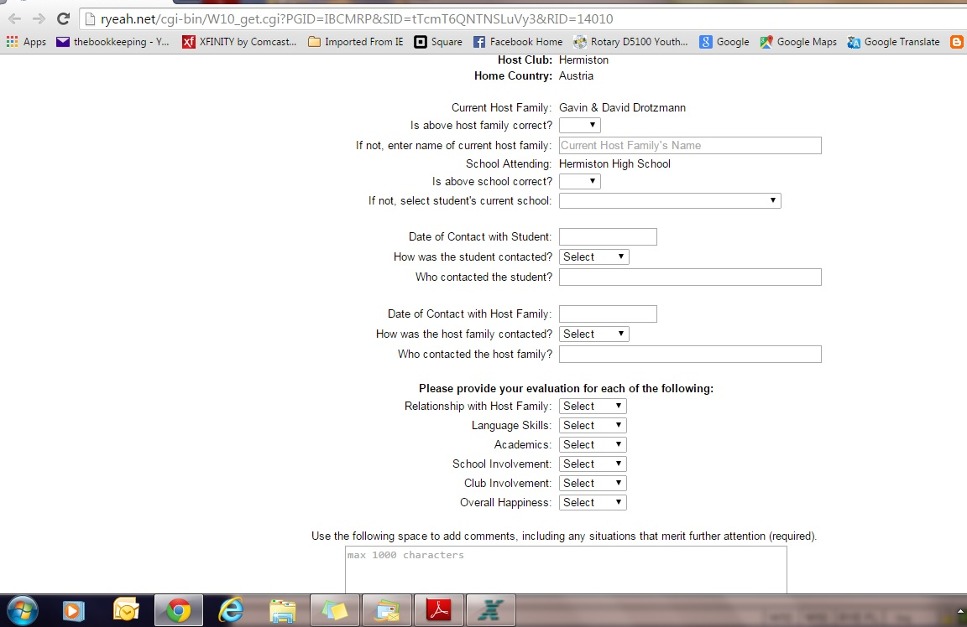
Monthly Report
Must have a date for both the Student contact and the HF contact. If you have a date for one but not the other, look up the last report submitted and use the date on it.

Slide 33
Host Family Change Report

Slide 34
New Inbound Needs
Need guarantee form filled out with Club information (HF, club counselor, school, President, Signatures in Blue Ink, Etc.)
Letter of acceptance from school
HF and Club counselor must be YEAH approved (fully vetted)
Fee $1450.00

Slide 35
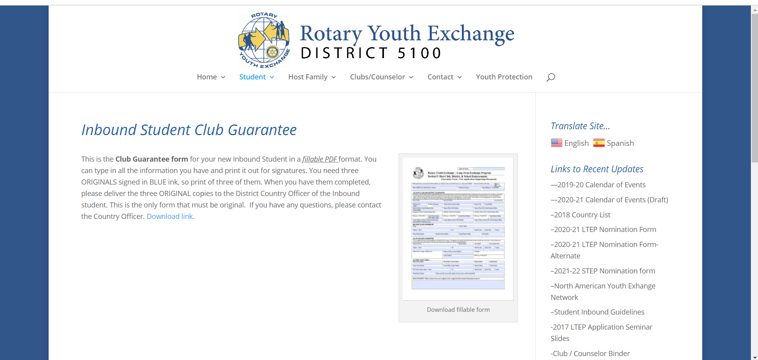
Where to find a blank Guarantee form
If you don’t have a first HF yet, use an already approved HF as a Welcoming family. Be sure to mark that on the Guarantee form, that it is a welcoming family so we know you are still looking for the first HF.
Notes:
‹#›

Slide 36
Another thing needed for new Inbound
Along with the guarantee
form, a letter from the
school on school letterhead
is needed. This is an
example.

Slide 37
Priorities for Inbounds
Your FIRST priority is to required scheduled District 5100 activities. There will be five or six of these during your year here, and unless you are advised otherwise, in writing, your attendance is required at each of these functions.
Your SECOND priority is to your host family. If they have planned activities in which they expect you to participate, they have priority over any other activity you might have planned, except Priority #1.
Your THIRD priority is to your host Rotary Club. They made the decision to host you, have paid your District Fees, and expect you to attend meetings regularly and be part of club activities. Your presence and participation help sustain the Youth Exchange Program in your host club.
Your FOURTH priority is to your School. You are expected to attend school every day, make an effort in class, and participate in school activities.
Please make sure your club understands the above.

Slide 38
Other advice
When traveling with students try to do the 3 rule. Travel with 3 people.
Have the club email the inbound before they arrive so they know what to expect.
You can do more than one monthly report each month. You can do as many as you need.

Slide 39
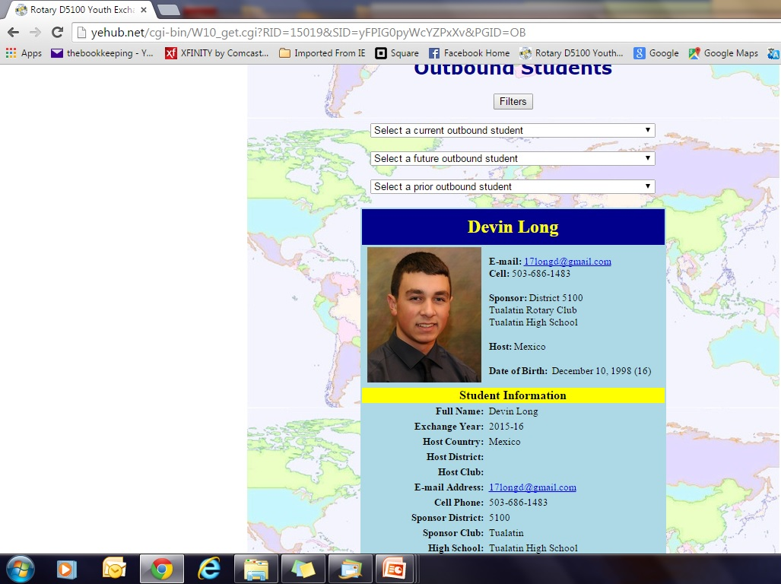
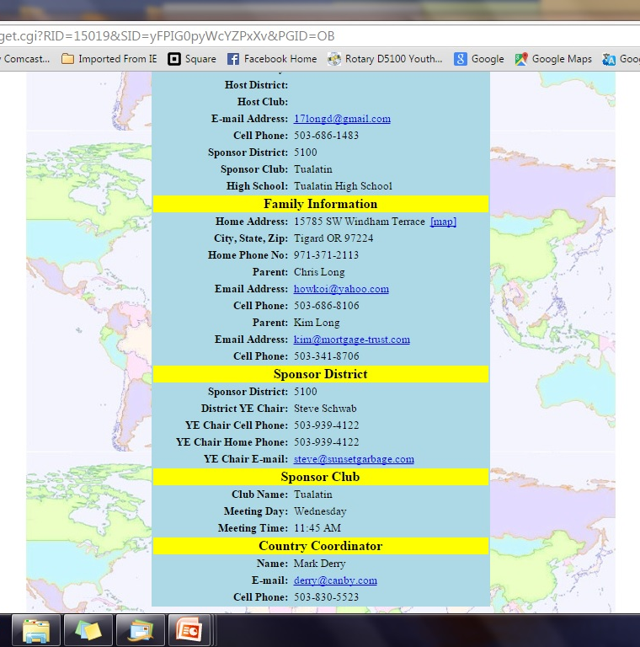
LTEP Outbound Students
Must send Outbound coordinator a nomination form so they can send the student a link to be able to do their application on YEAH.
The club must host an inbound if sending an outbound.
Must be sending an outbound before you can nominate an alternate.
Give us only 1 alternate.

Slide 40
Recruiting Students
Information night in Spring or September-Only give a week or two at the most to get club application to the club.
Give a quick background about Rotary, Service projects that your club does.
Steps to becoming an Exchange Student such as Club application, club interview, Application Seminar, Home Orientation with a District person in Nov-Dec, Jan. Orientation, Feb trip, Country dinners & District conference
Costs, how much the club pays. Other organizations cost would be $10,000-55,000 so this is basically a scholarship to study overseas-This is a student exchange-STUDENTS MUST ATTEND SCHOOL, Parents pay for Passport, visa, airline tickets Emergency Fund $500 and any extra trips
Promote LTEP, STEP and hosting. Give dates students leave or arrive and come or go home.
Should get school credit but each school is different so talk to school counselor. Can open doors for colleges.

Slide 41
Club Application

Slide 42
Where to find outbound interview

Slide 46
Interview Questions

Slide 49
To Start New Outbound student

Slide 50
Nomination form

Slide 51
Once Nominated, student will receive special link

Slide 52
Email with Links
sent to student after completing and submitting first section of application
From: Rotary D5100 Youth Exchange <d5100ye.youthexchange5100.org@yehub.net>
Subject: Application received; Follow-up documents and instructions
Date: March 24, 2020 at 7:25:46 PM PDT
To: tmohryeo@gmail.com
Reply-To: d5100ye@youthexchange5100.org
To: Terry Mohr, Rotary Youth Exchange Applicant Dear Terry, Thank you for completing the initial stage of the application process! You are on your way to completing the forms necessary to participate in the program. There are several additional time-sensitive documents required. Many of the forms require information from others, such as your physician, dentist, school, and Rotary Counselor - and you need to make appointments with each of them NOW - do not delay. ALL FORMS MUST BE TYPEWRITTEN as much as possible except for signatures and any clearly legible physician/dentist written notes. All signatures and written notes must be made in BLUE INK. All forms must be SCANNED in color and uploaded into the system. Photos will not work except for your passport and insurance ID card. Multiple page documents must be scanned together as one file but separated pages. DO NOT SCAN as single page. If you do not have a scanner ask for help from your Rotary Club or contact the Outbound Coordinator for assistance. Commonly missed requirements are the TB Test on the Medical Form, Witnesses for the Endorsement and Authorization Forms and the School Reference (See Second Link Below) . Be sure to retain all ORIGINAL COPIES of these forms as you will need them when you are working with the travel agency. Application must be complete by November 15, 2020. Incomplete applications past that date run the risk of not being accepted unless you have received a waiver from the outbound coordinator, have provided good reasons for the delay and a committment to have complete by a specific date. Please follow this link to obtain access to required documents: https://yehub.net/cgi-bin/W10_get.cgi?PGID=OBREQDOC&SID=l9yuliceJO6nSsQI (If you are unable to use this link, copy and paste the entire line into your browser) In addition, you are required to obtain a personal reference from a teacher or administrator at your school. The person you select should know you well, and be familiar with your academic accomplishments and your capabilities. At the link below, you will find a form for providing us with the name, phone number, and e-mail address of the person you wish to use as a reference. Before you submit this form, please talk to the person you select, to let him or her know that this request from Rotary Youth Exchange will be sent via e-mail, and that they should expect to receive it soon. Make sure you have a good and correct email address for them before you submit the form. https://yehub.net/cgi-bin/W10_get.cgi?PGID=OARFQ1&SID=l9yuliceJO6nSsQI (If you are unable to use this link, copy and paste the entire line into your browser) If you have any questions, please contact your Sponsor Club Youth Exchange Officer or the District Outbound Coordinator, Terry Mohr at tmohryeo@gmail.com

Slide 53
Alternate Nomination Form

Slide 54
Advice for Clubs
Have Outbounds speak at the club, have them tell what they are doing to get ready for exchange.
Have them do the presentation they will need to do in their host clubs
Have them be a greeter or a Sgt at Arms

Slide 55
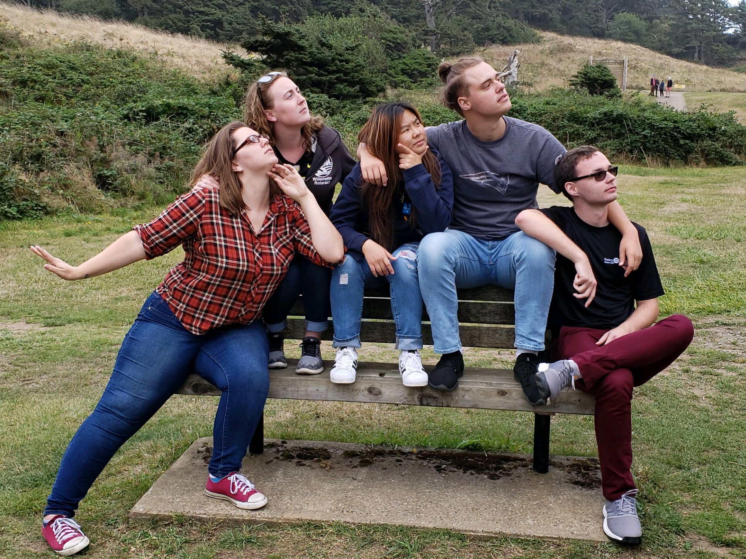
YOUR FAVORITE D5100 ROTEX
Chartering Soon!
Purpose
The purpose of Rotex is to support District 5100 Rotary Youth Exchange (RYE) students in every stage of the program, including former participants; and to assist in the administration of the program to such extent as determined in cooperation with the District Youth Exchange Committee (DYEC).
How are we helping?
Providing Rotex with an opportunity to network and socialize with one another
Assisting the DYEC in planning, updating, and execution of its orientations and other activities
Providing support to the Rebound, Inbound, Outbound Candidate, and Outbound students and their families
Assisting Rotary clubs in raising awareness of RYE in their communities, finding Outbound Candidates, finding host families, welcoming Inbounds to their schools and communities, and re-integrating Rebounds
Encouraging RYE participants to continue in some aspect of the Rotary organization at some time following the conclusion of their exchange

Slide 56
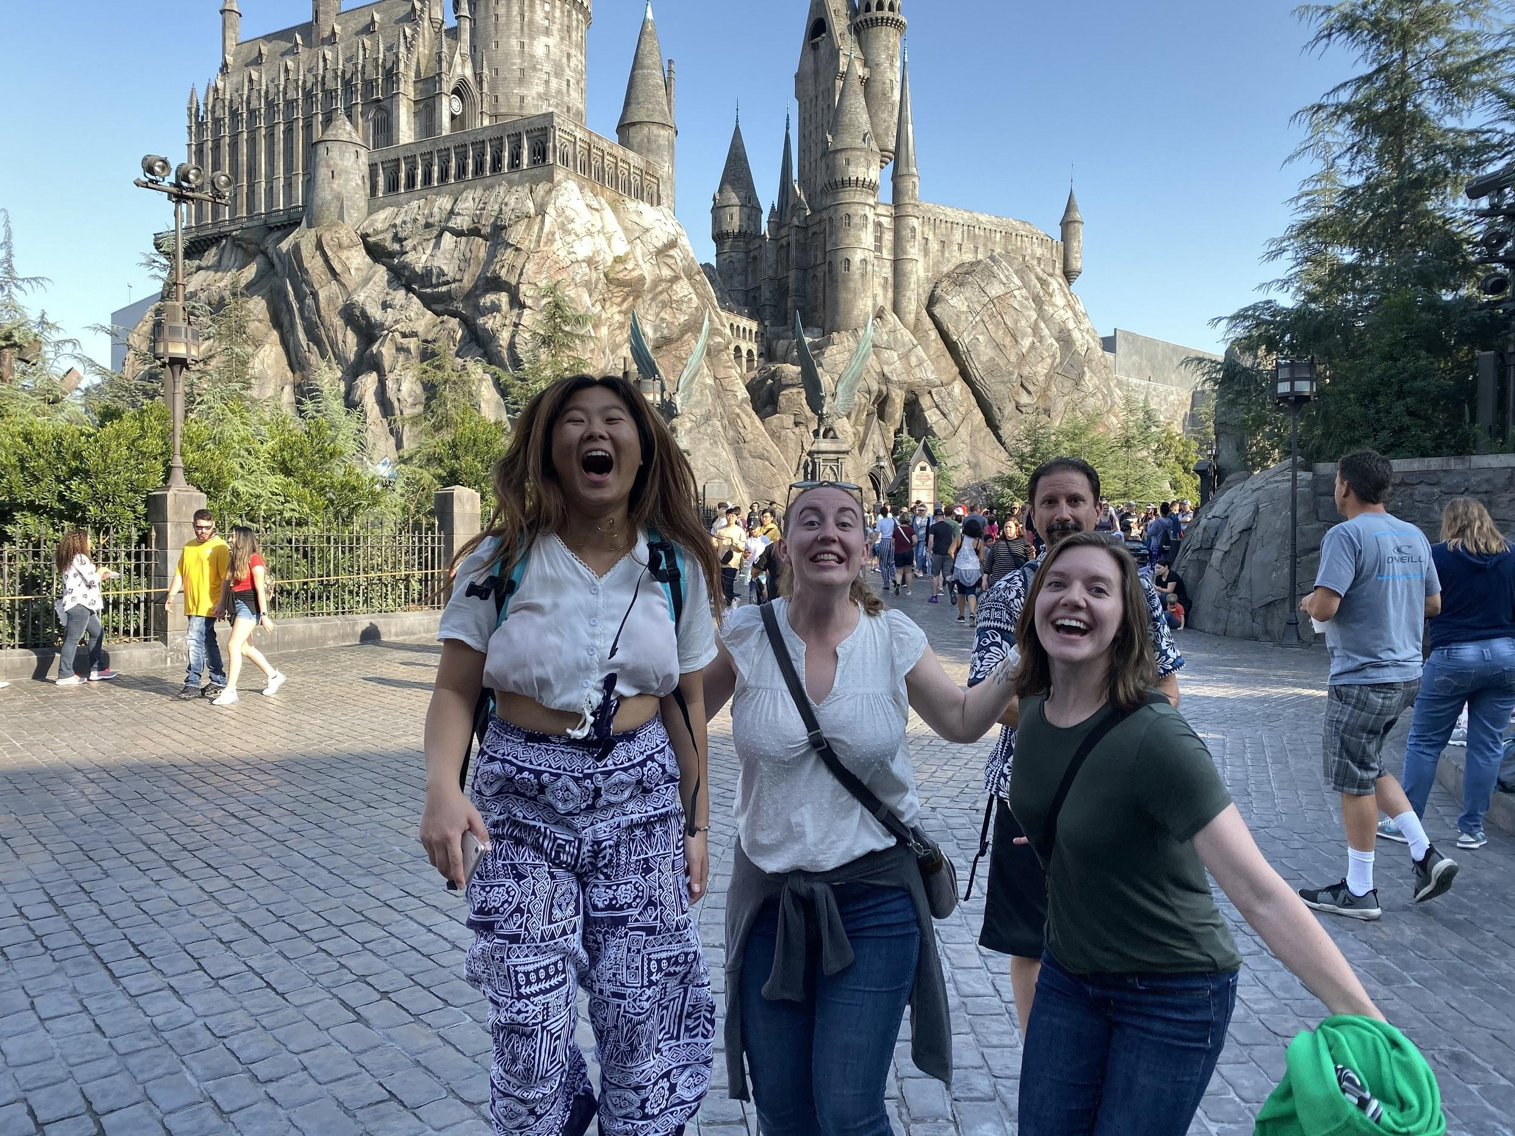
YOUR FAVORITE D5100 ROTEX
Chartering Soon!
Contact Us:
email. 5100rotex@gmail.com
instagram. @yourfav5100rotex

Slide 57
Short Term
Tina Scheible
Res: 503.659.3485
Cell: 971.258.8839
Email: tina.scheible@gmail.com
Address: 14888 SE Cedar Ave
Milwaukie, Oregon 97267 USA

Slide 58
STEP General Information
Student eligibility will run from the summer between the eighth grade and freshman year of high school to the summer between the first and second year of college. However, most student participants are still in high school.
The age range is 15 to 19 years of age.
Students may be from families of either Rotarians or non-Rotarians.
Students will be nominated and interviewed by the Rotary club in the area in which they live.
Clubs may nominate more than one student.
Students may be eligible to go on a Short Term Exchange more than once.

Slide 59
Specific Club and Student/Host Family Instructions
The club will interview the student and family in their home. The club must have agreement from the family that they will host a student during the same summer exchange period as their son or daughter.
The family will go through the same online Host Family approval process as any host family in YEAH. Please don’t start the host family process until at least fall of 2020
Clubs submit STEP nomination form to Tina Scheible by September 30th.
The student will receive a link to the online STEP application at the Application Seminar on October 3rd or soon after. The link will send the student to the online application process which is similar to the LTEP.

Slide 60
STEP Instruction Continue
The student submits the completed online STEP application by October 31st. At that point, the student will get a prompt for four more documents. All signatures should be in Blue Ink.
A check of $450 from the family made out to D5100 Rotary YEC must accompany the application or Nomination form.
Clubs nominating students after November 1st will be reviewed on a case by case basis.
Students and their parents are required to attend the outbound student orientation to be held in January, and a morning orientation held in May.
NOTE: At the January orientation, students will make their final choices for country preferences for short term exchange.
Tina can not look for an exchange match until the family is an approved host family.

Slide 61
• STEP EXCHANGE COUNTRIES
We have established exchanges with most European Countries, as well as Japan, Brazil, Mexico, Argentina, Turkey, Thailand, Taiwan, and Australia. We will attempt to establish a short term exchange relationship with any country a student requests that has a certified Rotary Short Term Exchange program in place, as long as the student enters the program prior to October 31st deadline.
Exchange with Southern Hemisphere countries such as Brazil, Argentina, Peru, Australia, and Chile will be “staggered” exchanges, meaning students will be going there during our summer, and their match will be coming here during our winter (their summer). Staggered exchanges can be for longer periods of time than the basic four week “summer” exchange, but cannot exceed 90 days in length. Because of this, foreign students coming here attend school for several weeks as an observer. A few other countries (Ecuador, Iceland, Thailand and India) are also staggered but still four weeks. Those students come here in the spring before our student goes. Staggered exchanges can only happen if prior to the summer of the exchange, the student and/or their family gets written approval from their local high school and their sponsoring club.
STEP students are not here on a student visa but rather a visitor’s visa

Slide 62
Miscellaneous STEP Information
All travel arrangements will be made by a district designated travel agent. Rotary does not accept the use of air miles or ordering tickets through the Internet, as they do not provide guaranteed seating.
Travel will take place at times agreed upon by the exchanging districts. Both districts must approve exceptions to the coordinated travel policy. Host families work together on the exact dates of the exchanges, and make the travel arrangements through the designated travel agent.
The fee will cover the cost of orientations, the Rotary polo shirt, the business cards introducing the student as a rotary exchange student, and any processing and mailing costs.
The $450 fee is refunded if the student’s application is rejected by the club nominating the student before the January orientation takes place. The fee is not refundable if the student drops out of the program after the orientation in January.

Slide 63
Questions??

